Slide 1


Presentation Deep Learning Project
MAP583 – Deep Learning
Handwriting synthesis
Nicolas HUOT & Alexis BOULEY
March 2022

Slide 2
Introduction

Slide 3
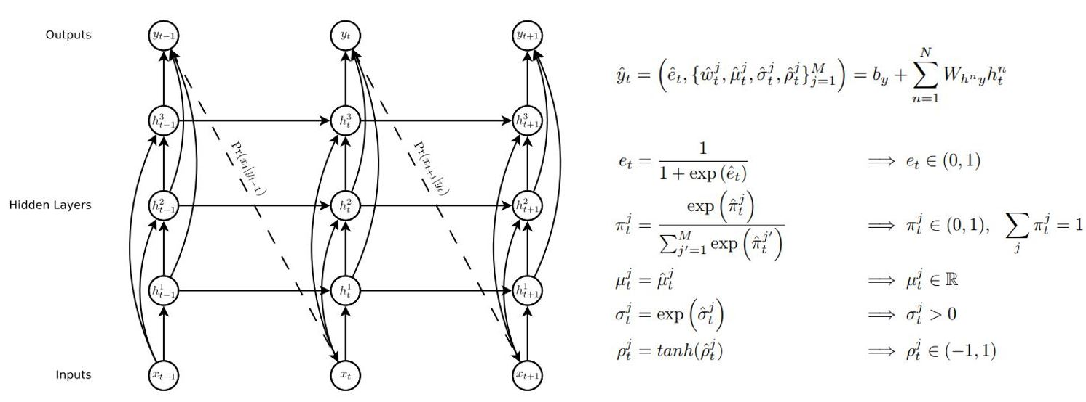
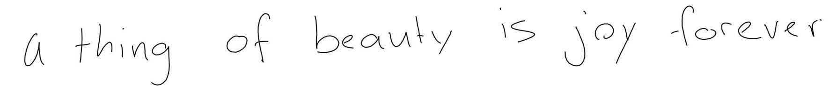
1) Introduction
Handwriting synthesis
Input:
« a thing of beauty is joy forever »
Output:

Slide 4
Goal

Slide 5
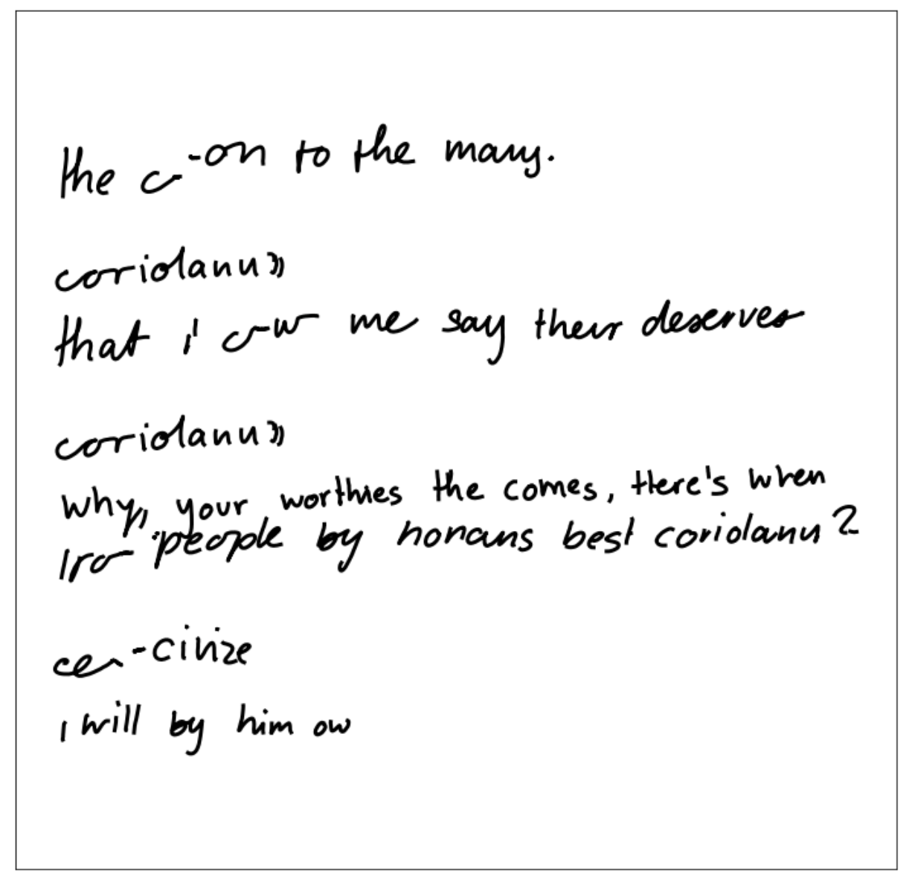
1) Goal
Design a writing smoothener
Shakespeare texts generation

Slide 6
Contents
Prediction models
Sampling
Unbiased
Biased
Primed
Problem solving
Writing smoothener
Shakespeare texts generation
Conclusion

Slide 7
1) Prediction models

Slide 8
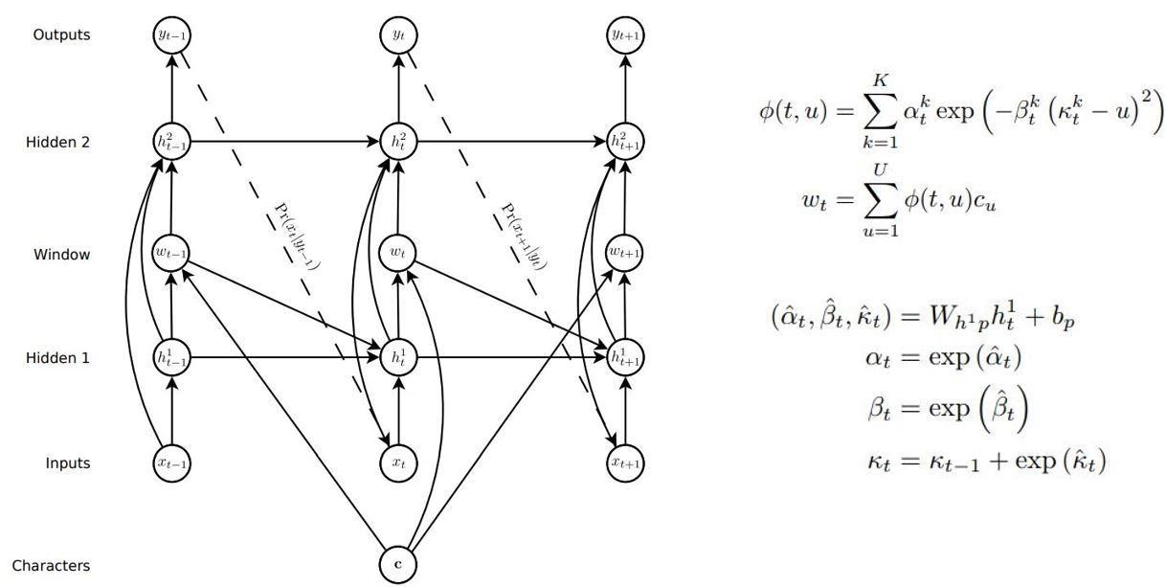
1) Prediction models
Unconditional model
Conditional model

Slide 9


1) Prediction models
Next point prediction
Gaussian mixture

Slide 10
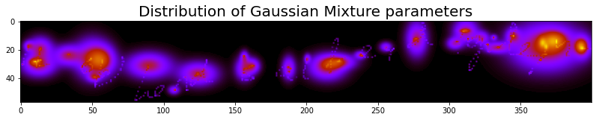
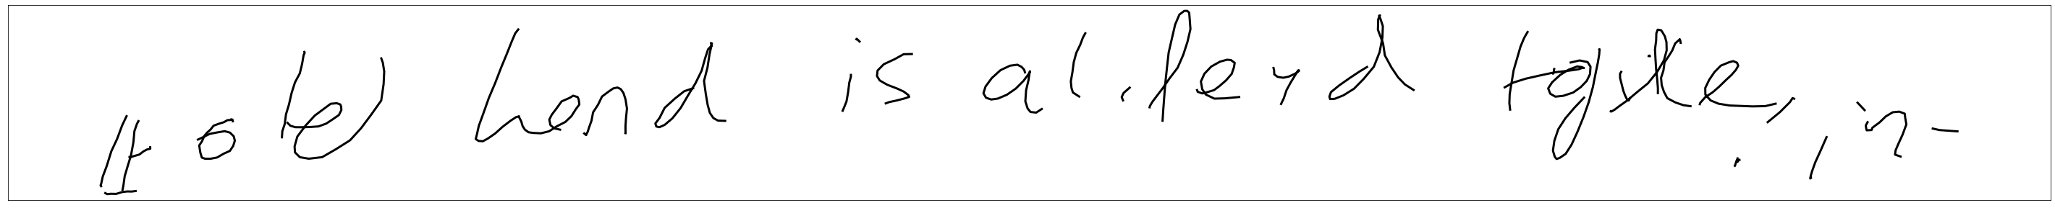
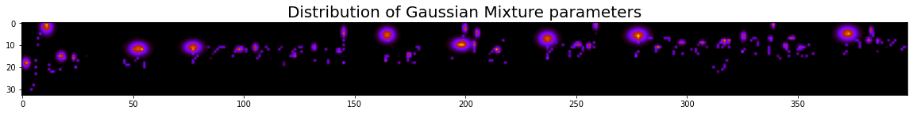
1) Prediction models
Prediction visualisation
Unconditional model
Conditional model

Slide 11
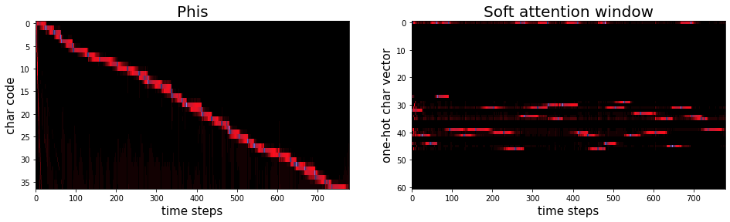
1) Prediction models
Attention mechanism for conditional model

Slide 12
2) Sampling

Slide 13

2) Sampling
Unbiased sampling
attention:
T H E

Slide 14
2) Sampling
Biased sampling
attention:
T H E

Slide 15
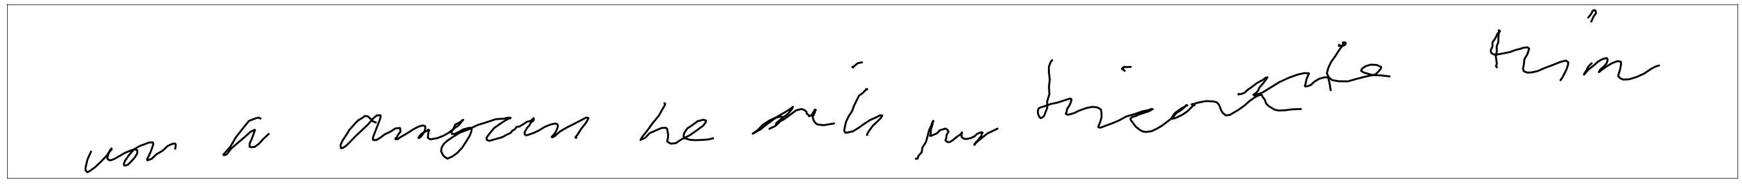
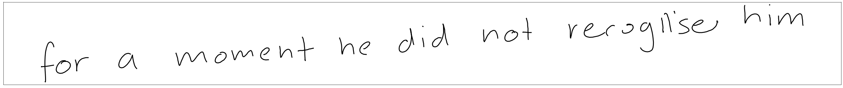
2) Sampling
Trade-off : Diversity / Cleanliness
b=0
Unreadable
b=0,4
b=0,8
b=1,2
b=1,6
b=2
b=2,4
Lack of diversity
b=2,8
b>2,8

Slide 16
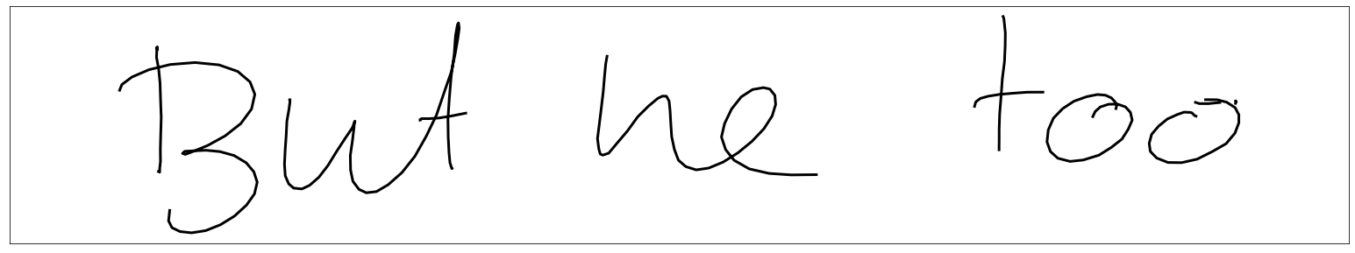
2) Sampling
Primed sampling
Handwriting synthesis
attention:
Primer + Generated text

Slide 17
2) Sampling
Ideas for improving primed sampling
Using a high bias
Problem at startup:
Attention manipulation by concentrating it on the first character
Only keep the hidden state and give only the generated sentence for the condition

Slide 18
2) Sampling
Transition word
Génération d’écriture
attention:
texte d’amorce + mot de transition + texte généré
Primer:
Handwriting synthesis without transition word:
Handwriting synthesis with transition word:

Slide 19
3) Problems solving

Slide 20
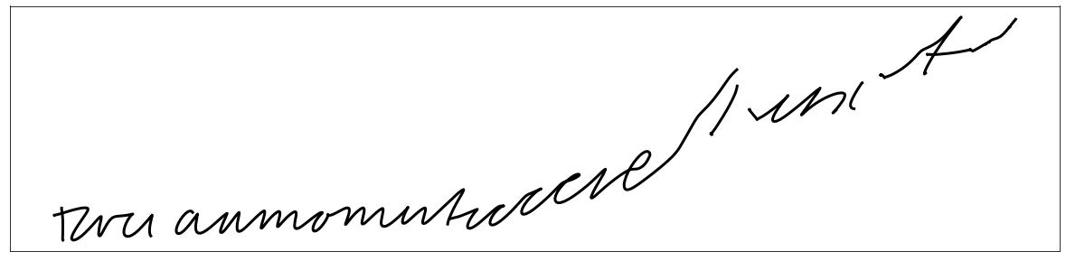

3) Problems solving
Writing smoothener
+ « For a moment, he didn’t recognise him »
Handwriting synthesis model
Generation
Sélection

Slide 21
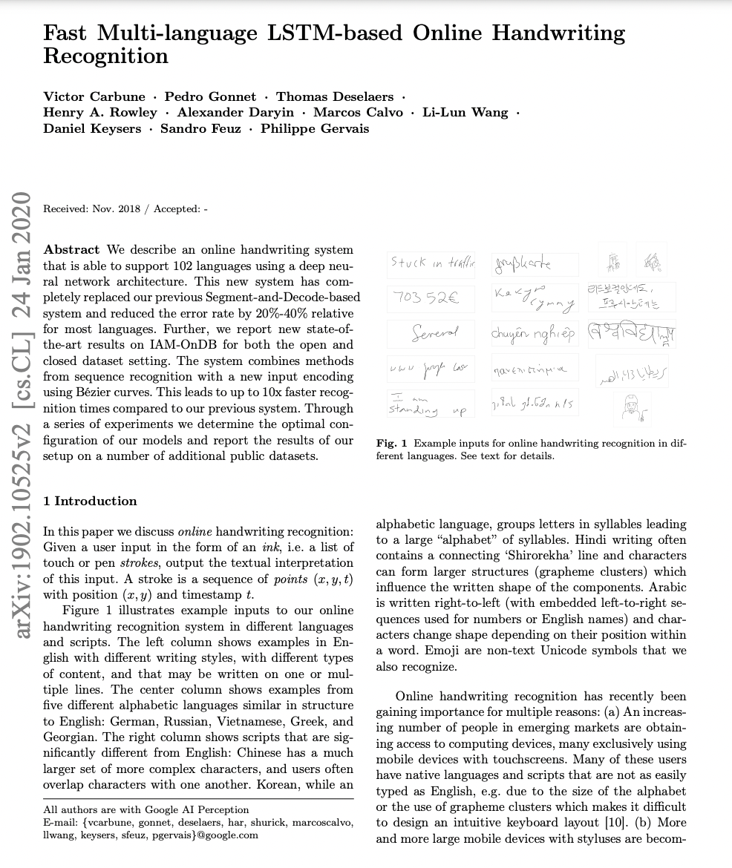

3) Problems solving
Selection:
Idea 1: use a online handwriting recognition model
Paper: Fast Multi-language LSTM-based Online Handwriting Recognition
« For a mokment, he didn’tk recogse him »
« For a moment, he didcognise him »
Generation
« lr a moment, he didn’llognise him »
Recognition
« For a mlent, he didn’t recognise him »
« For a loment, he lln’t recognise him »
« For a moment, he didn’t recognise him »
« For a moment, he didn’t recognise him »
Model too complex to be implemented quickly and public code unusable

Slide 22
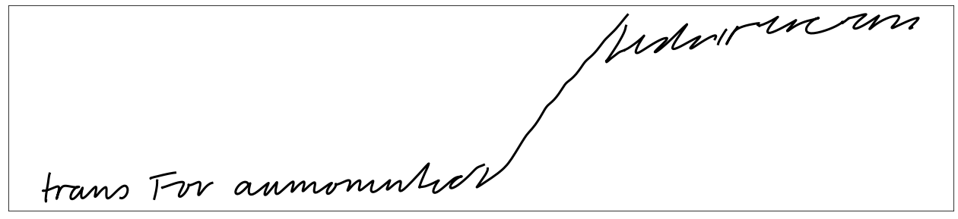
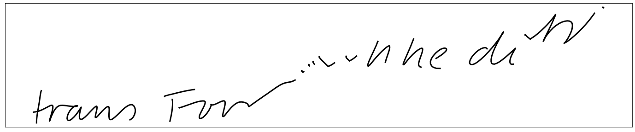
3) Problems solving
Selection:
Idea 2: Create a recognition model to assess the handwriting quality
LSTM
Handmade database:
0
1
0,87
0
1

Slide 23
3) Problems solving
Selection:
Idea 3: Evaluating the quality of handwriting with the loss of the unconditional model
High loss
Low loss

Slide 24
3) Problems solving
Result:
Smoothener
Smoothener
Smoothener

Slide 25
3) Problems solving
Generation of Shakespeare texts:
GRU
GRU
Architecture:
T
H
E
…
Data : https://homl.info/shakespeare

Slide 26
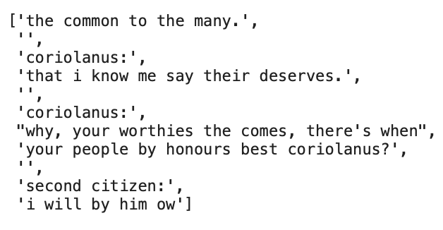
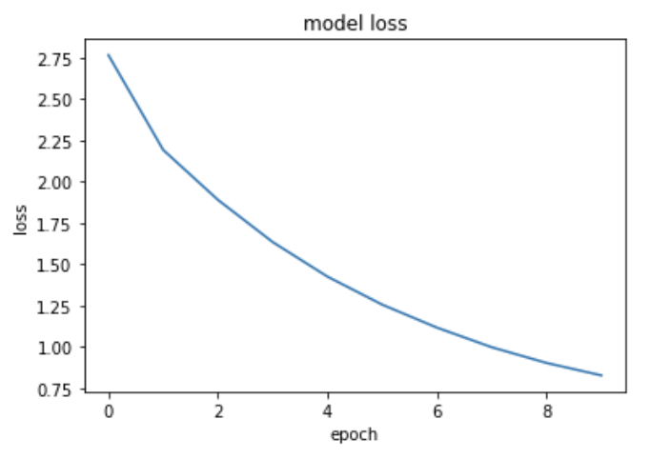
3) Problem solving
Result
Handwriting generation
Text generation

